Slide 1
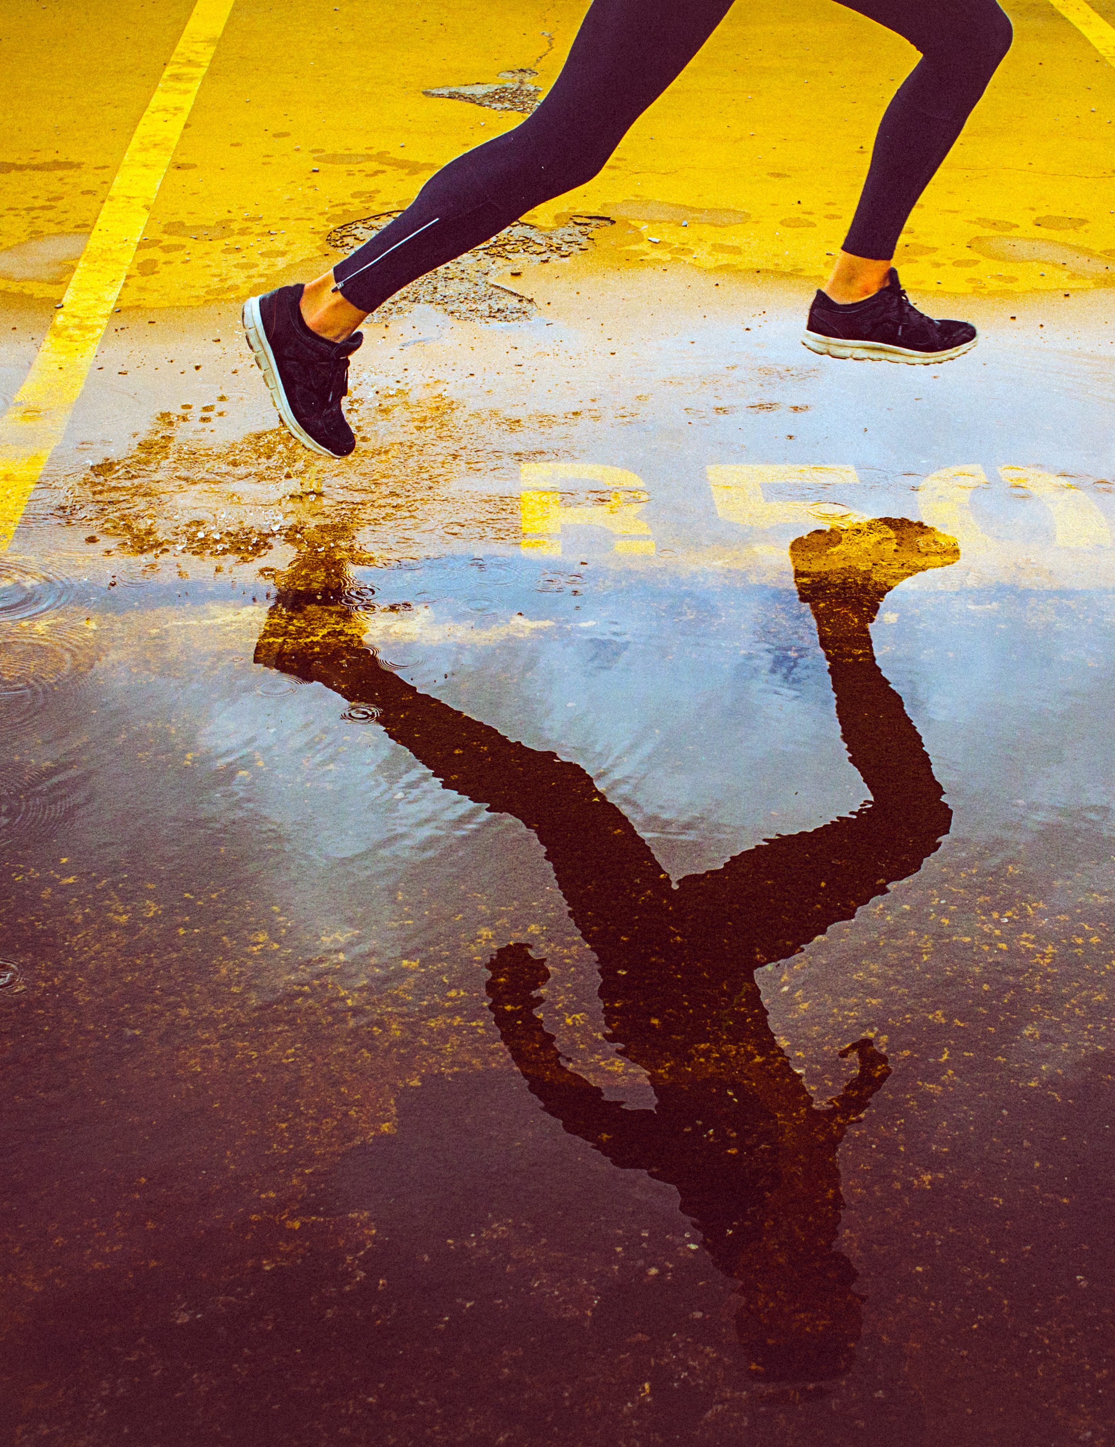
Last minute rush!
Solved by:
Aidan, Ali, Gaurav, Pankaj and Sharod

Slide 2
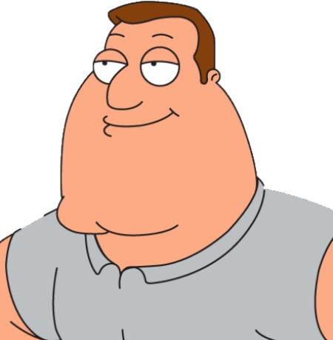
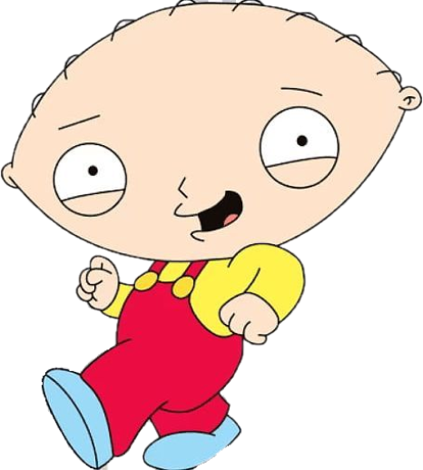
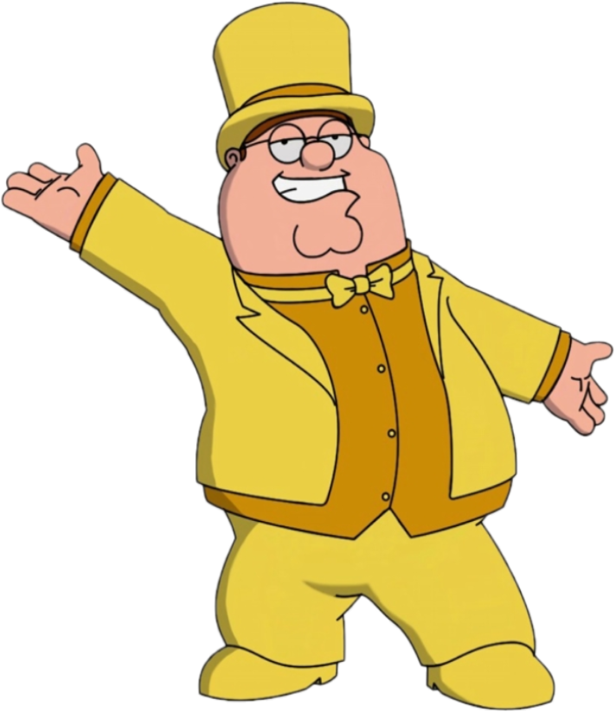
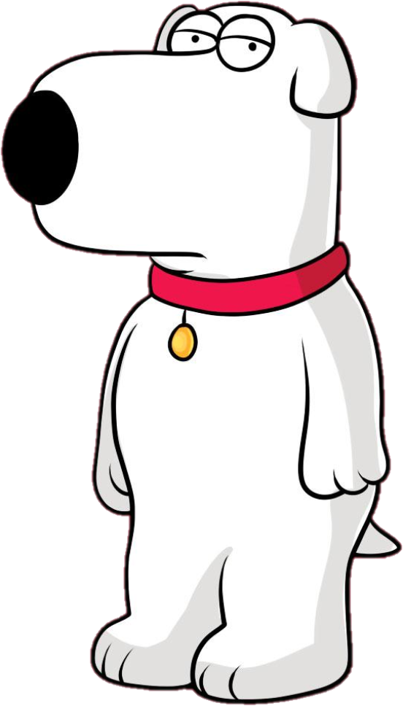
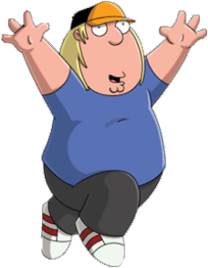
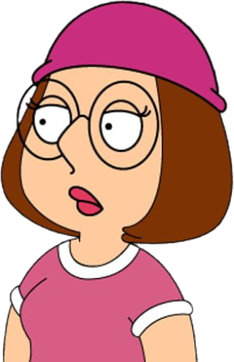
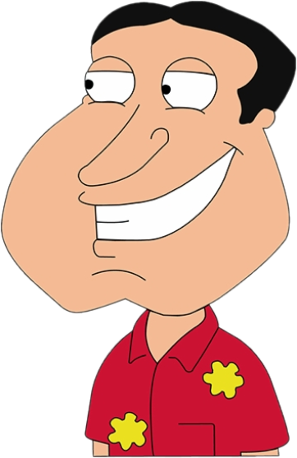
Let’s understand the players
Stewie
Joe
Peter
Chris
Glenn
Meg
brian
Event Organizer
(Concert, Movie Theatre,
Sports Events, etc.)
First Buyer
(Purchases the ticket directly
from event organizer)
Late Buyers
(Purchases the ticket first
Buyers via Auction or at premium)
Know it all Blockchain Expert

Slide 3
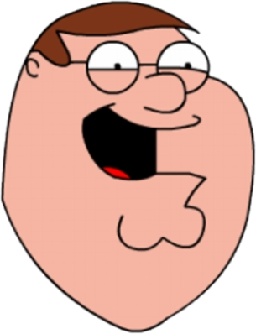
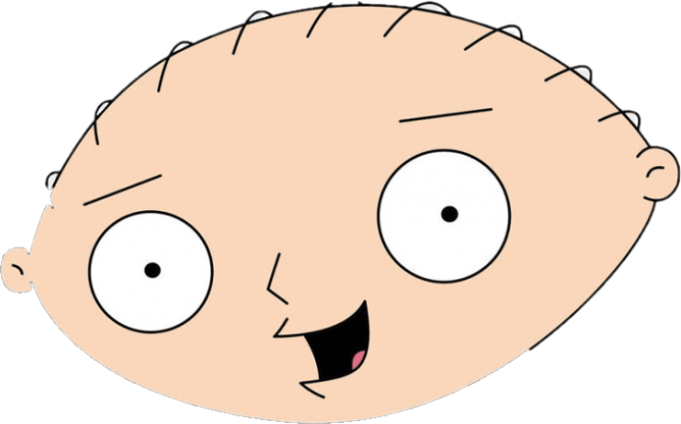
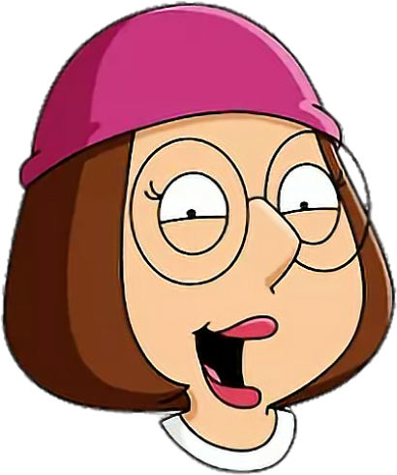
Scenario - I
Stewie buys Avengers Endgame
ticket from Peter for $20
Now, Meg afraid that someone will spoil the ending for her,
she buys same ticket from Stewie for $40

Slide 4
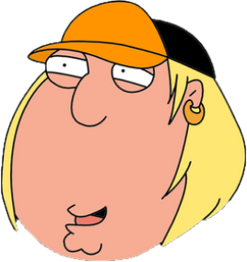

Scenario - II
Peter the painter sells his painting
to Chris for $500
3 years later as Peter becomes recognized, same painting is
sold to Glenn for $10,000 at an Auction.

Slide 5
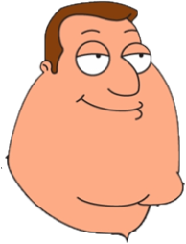
Scenario - III
Peter sells NBA Final courtside
tickets to Chris for $350
With his favorite team in finals, Joe decides to buy
the tickets from Chris at $500

Slide 6
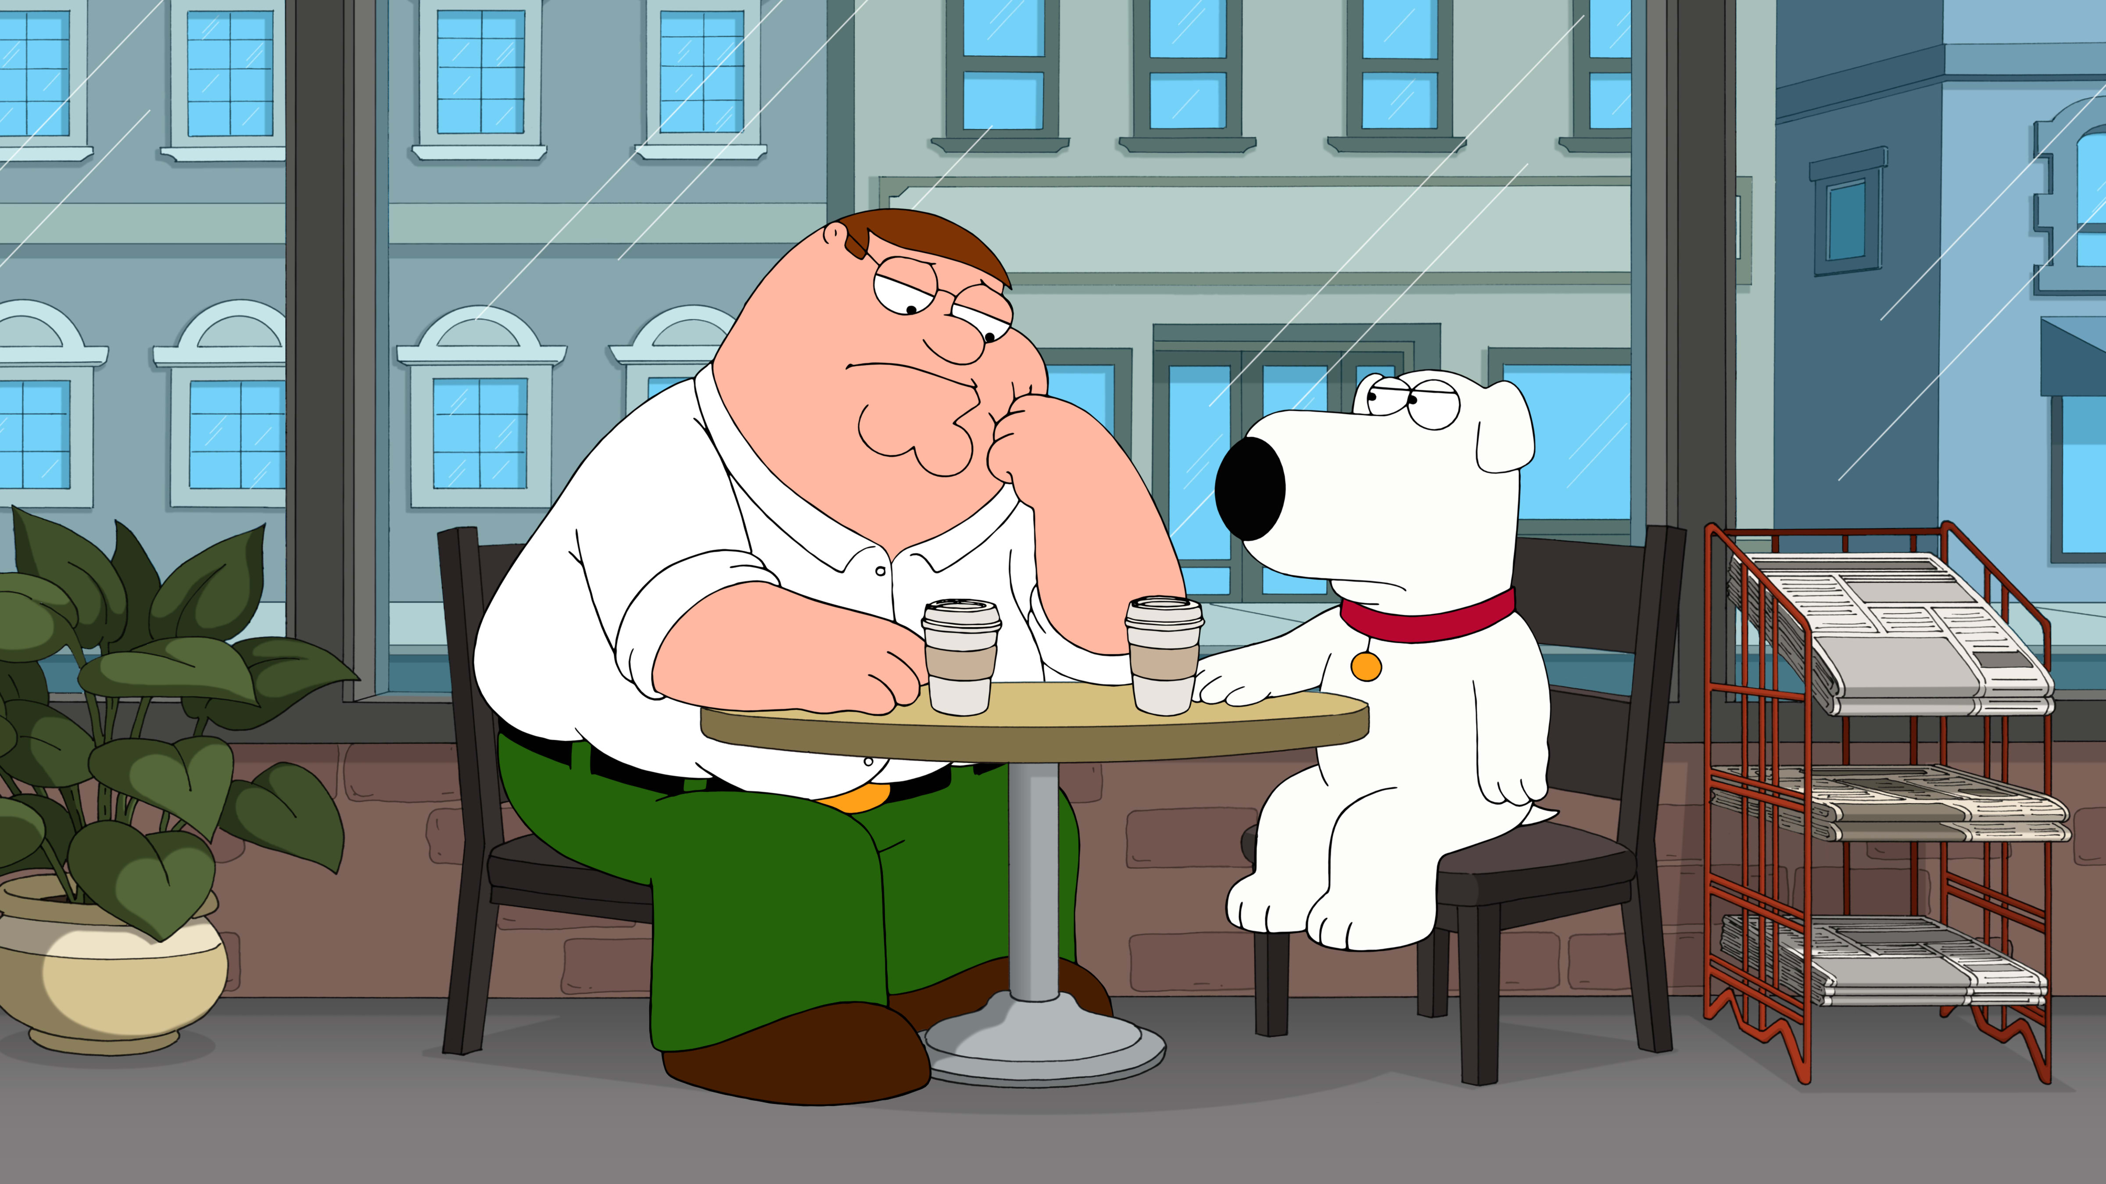
How can I ensure that there are no resells of the tickets or maintain the authenticity of the tickets sold at major sports events or even at the Auction?
You are thinking way too much. All this can be easily solved if you tokenize what you sell.
Let’s have the team show it to you.

Slide 7
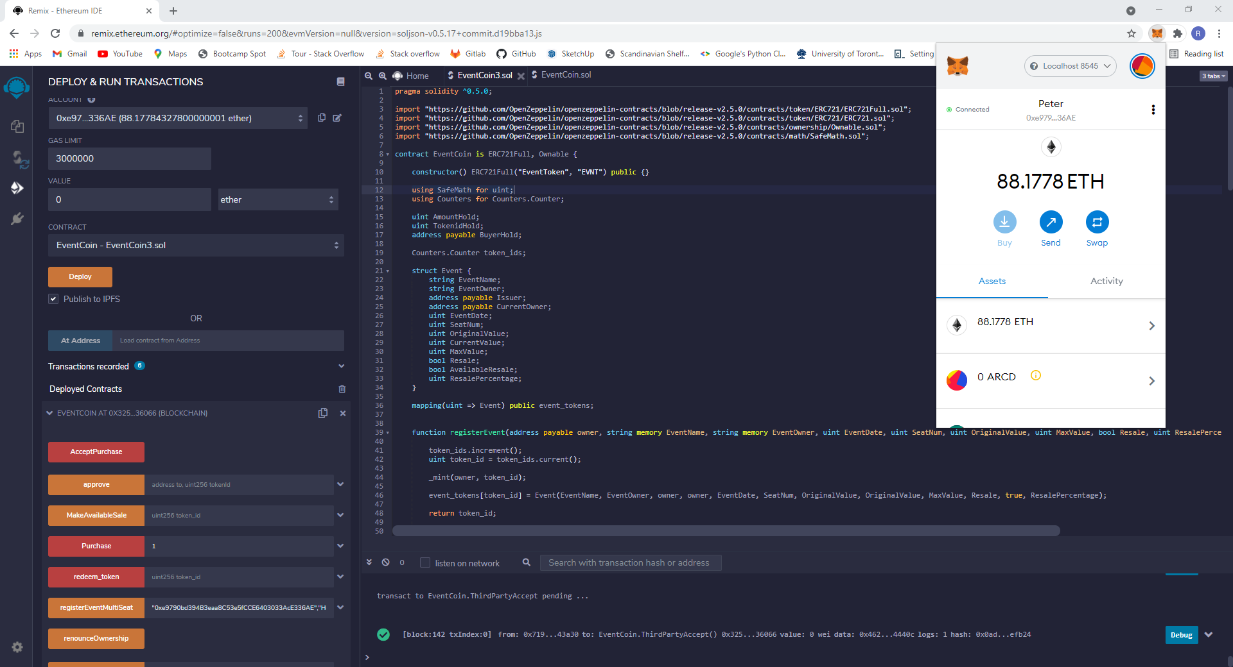
Safe Purchase contract

Slide 8
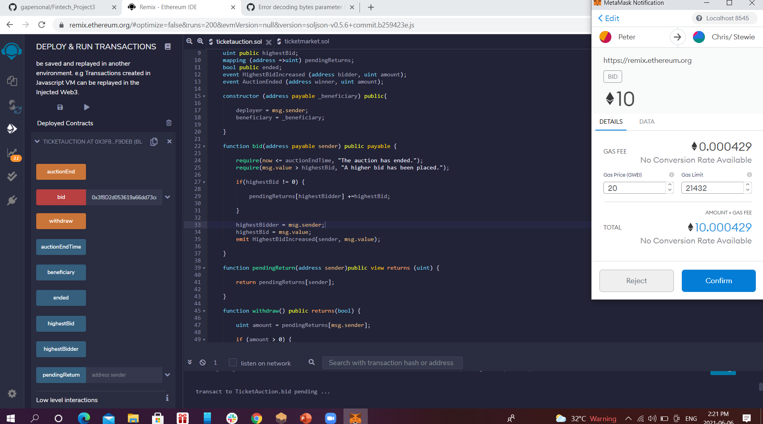
Ticket Contract

Slide 9
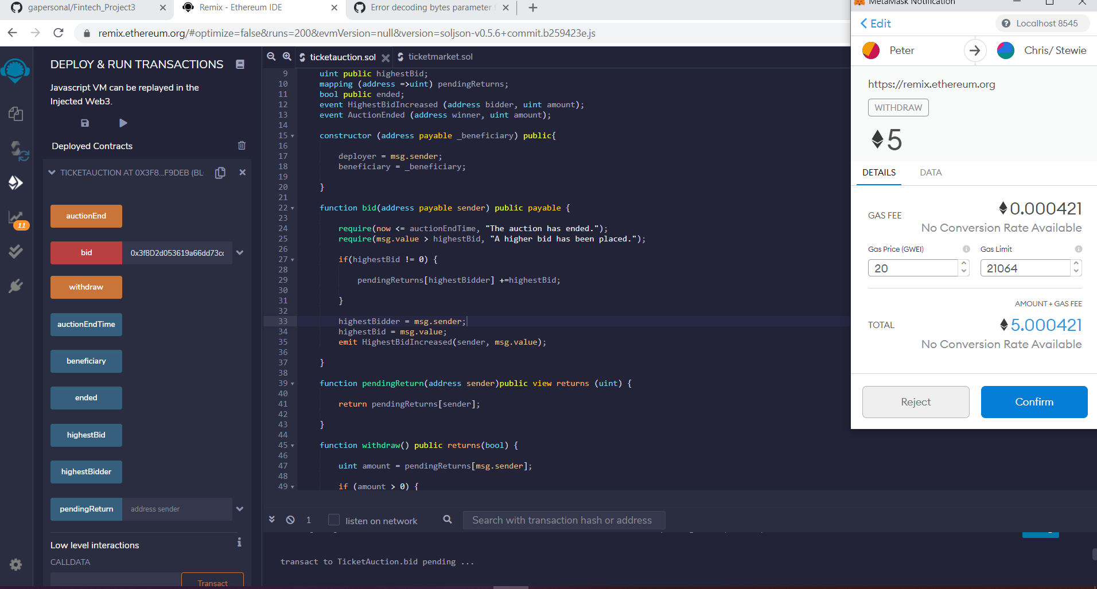
Blind auction Contrat

Slide 10
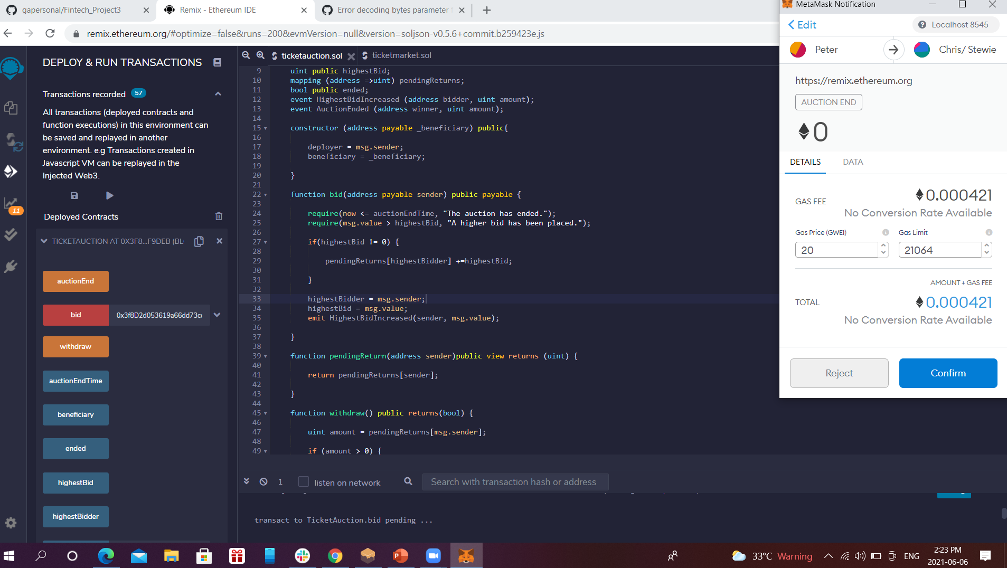

Slide 11
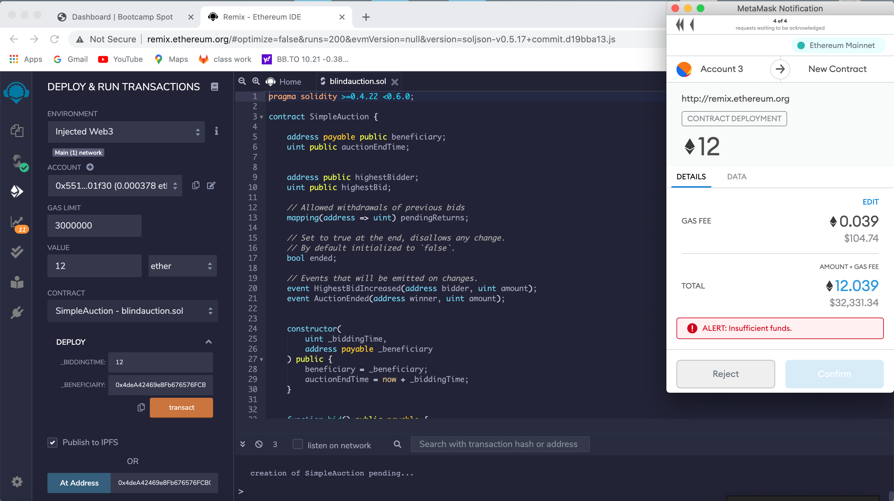
Blind Auction

Slide 12
Production Ready?
We would like to provide the interactive front-end to transact instead of Solidity
Add another layers of complexity where Owner’s cut/ percentage is variable based on the date of resale

Slide 13
Conclusion
Demonstrated contracts suggests the possible use cases where blockchain can be implemented
Event organizers should look to tokenize the items/ tickets sold
Blockchain in this instance will ensure the authenticity of the item sold, control the resale and/ or define the terms of resale at the origination to control the market
Contradicts the idea of free market
Cost of creating a token impacts the viability

Slide 14
Thank you

